Slide 1
Learning in Neural Networks
Neurons and the Brain
Neural Networks
Perceptrons
Multi-layer Networks
Applications
The Hopfield Network

Slide 2
Introduction, or how the brain works
Machine learning involves adaptive mechanisms that enable computers to learn from experience
  learning by example.
Learning capabilities can improve the performance of an intelligent system over time.
The most popular approach to machine learning is artificial neural networks.

Slide 3
Neural Networks
A model of reasoning based on the human brain
complex networks of simple computing elements
capable of learning from examples
  with appropriate learning methods
collection of simple elements performs high-level operations

Slide 4
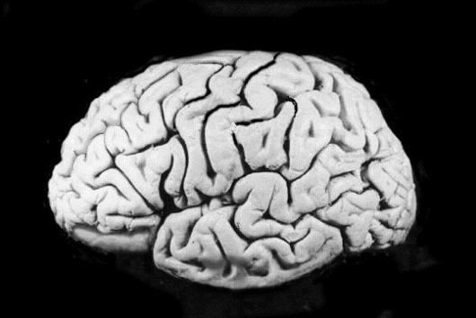
Neural Networks and the Brain
brain
  set of interconnected modules
  performs information processing operations
    sensory input analysis
    memory storage and retrieval
    reasoning
    feelings
    Consciousness
neurons
  basic computational elements
  heavily interconnected with other neurons
[Russell & Norvig, 1995]

Slide 5
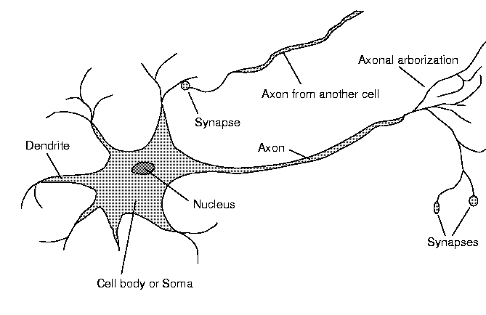
Neuron Diagram
soma
  cell body
dendrites
  incoming branches
axon
  outgoing branch
synapse
  junction between a dendrite and an axon from another neuron
[Russell & Norvig, 1995]

Slide 6
Neural Networks and the Brain (Cont.)
The human brain incorporates nearly 10 billion neurons and 60 trillion connections between them.
Our brain can be considered as a highly complex, non-linear and parallel information-processing system.
Learning is a fundamental and essential characteristic of biological neural networks.

Slide 7
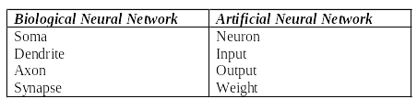
Analogy between biological and artificial neural networks

Slide 8
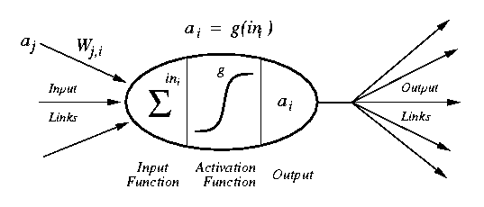
Artificial Neuron (Perceptron) Diagram
[Russell & Norvig, 1995]
weighted inputs are summed up by the input function
the (nonlinear) activation function calculates the activation value, which determines the output

Slide 9
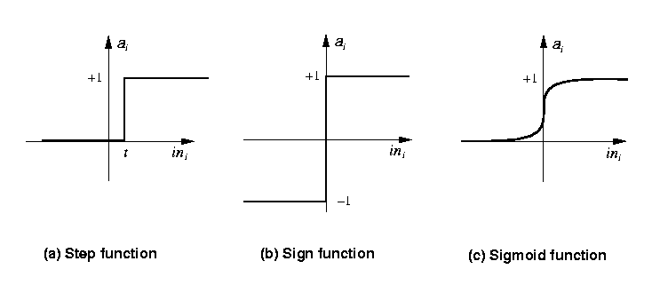
Common Activation Functions
[Russell & Norvig, 1995]
Stept(x) = 1 if x >= t, else 0
Sign(x) = +1 if x >= 0, else –1
Sigmoid(x) = 1/(1+e^{-x})

Slide 10
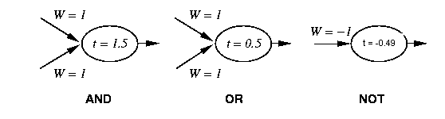
Neural Networks and Logic Gates
[Russell & Norvig, 1995]
simple neurons can act as logic gates
  appropriate choice of activation function, threshold, and weights
    step function as activation function

Slide 11
Network Structures
layered structures
  networks are arranged into layers
  interconnections mostly between two layers
  some networks may have feedback connections

Slide 12
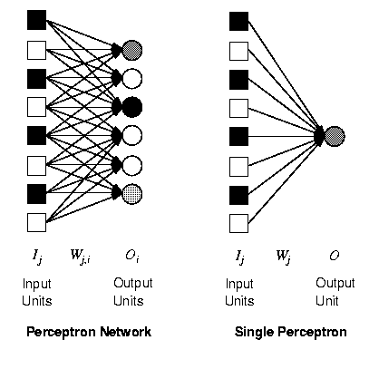
Perceptrons
single layer, feed-forward network
historically one of the first types of neural networks
  late 1950s
the output is calculated as a step function applied to the weighted sum of inputs
capable of learning simple functions
  linearly separable
[Russell & Norvig, 1995]

Slide 13
Perceptron
In 1958, Frank Rosenblatt introduced a training algorithm that provided the first procedure for training a simple ANN: a perceptron.
The aim of the perceptron is to classify inputs (x1, x2, . . ., xn) into one of two classes, say A1 and A2.

Slide 14
Perceptrons and Linear Separability
0,1
1,1
0,1
1,1
0,0
1,0
0,0
1,0
AND
XOR
[Russell & Norvig, 1995]
perceptrons can deal with linearly separable functions
some simple functions are not linearly separable
  XOR function

Slide 15
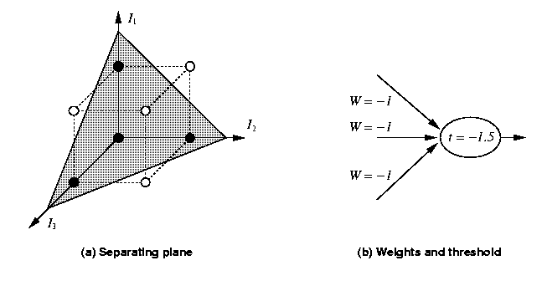
Perceptrons and Linear Separability
[Russell & Norvig, 1995]
linear separability can be extended to more than two dimensions
more difficult to visualize

Slide 16
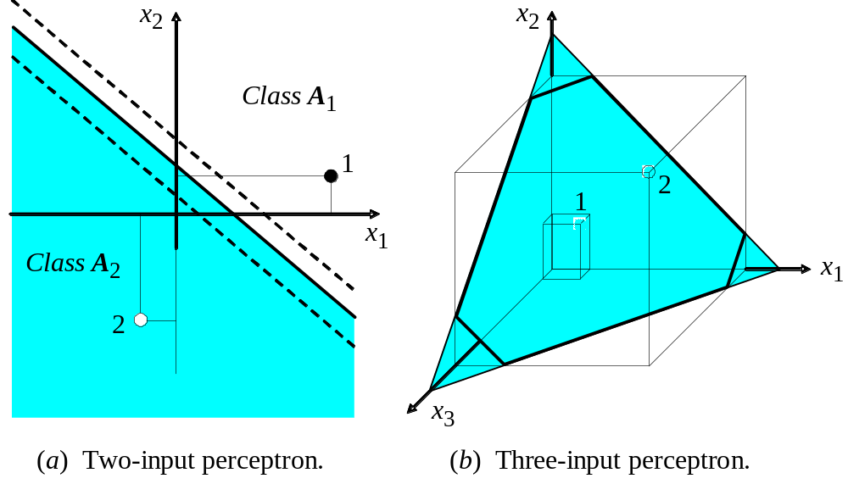
Perceptrons and Linear Separability

Slide 17
How does the perceptron learn its classification tasks?
This is done by making small adjustments in the weights
  to reduce the difference between the actual and desired outputs of the perceptron.
The initial weights are randomly assigned
  usually in the range [−0.5, 0.5], or [0, 1]
Then the they are updated to obtain the output consistent with the training examples.

Slide 18
Perceptrons and Learning
perceptrons can learn from examples through a simple learning rule. For each example row (iteration), do the following:
  calculate the error of a unit Err_{i} as the difference between the correct output T_{i} and the calculated output O_{i}
  Err_{i} = T_{i} - O_{i}
  adjust the weight W_{j} of the input I_{j} such that the error decreases
  W_{ij} = W_{ij} + α *I_{ij} * Err_{ij}
    α is the learning rate, a positive constant less than unity.
  this is a gradient descent search through the weight space

Slide 19
Generic Neural Network Learning
basic framework for learning in neural networks
function NEURAL-NETWORK-LEARNING(examples) returns network
network := a network with randomly assigned weights
for each e in examples do
O := NEURAL-NETWORK-OUTPUT(network,e)
T := observed output values from e
update the weights in network based on e, O, and T
return network
adjust the weights until the predicted output values O
and the observed values T agree

Slide 20
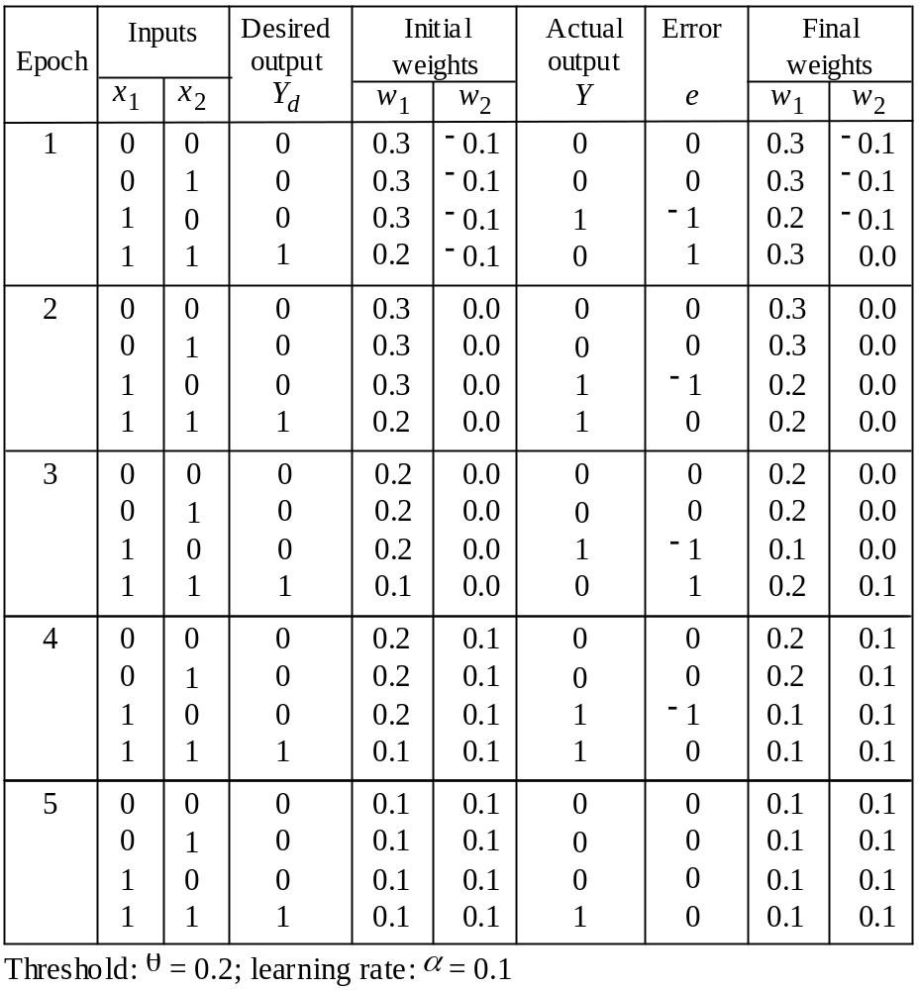
Example of perceptron learning: the logical operation AND

Slide 21
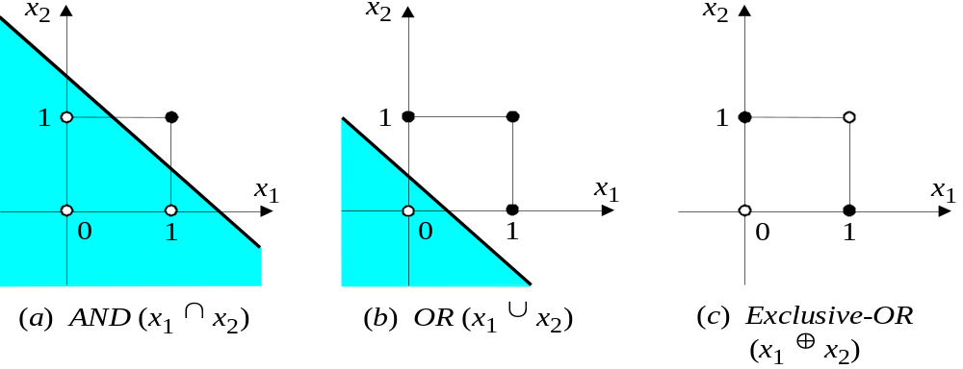
Two-dimensional plots of basic logical operations
A perceptron can learn the operations AND and OR, but not Exclusive-OR.

Slide 22
Multi-Layer Neural Networks
research in the more complex networks with more than one layer was very limited until the 1980s
  learning in such networks is much more complicated
  the problem is to assign the blame for an error to the respective units and their weights in a constructive way
the back-propagation learning algorithm can be used to facilitate learning in multi-layer networks

Slide 23
Multi-Layer Neural Networks
The network consists of an input layer of source neurons, at least one middle or hidden layer of computational neurons, and an output layer of computational neurons.
The input signals are propagated in a forward direction on a layer-by-layer basis
  feedforward neural network
the back-propagation learning algorithm can be used for learning in multi-layer networks

Slide 24
Diagram Multi-Layer Network
two-layer network
  input units I_{k}
    usually not counted as a separate layer
  hidden units a_{j}
  output units O_{i}
usually all nodes of one layer have weighted connections to all nodes of the next layer
O_{i}
W_{ji}
a_{j}
W_{kj}
I_{k}

Slide 25
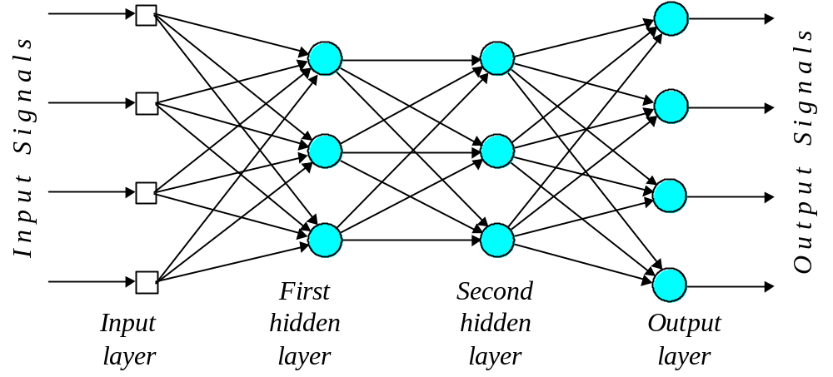
Multilayer perceptron with two hidden layers

Slide 26
What does the middle layer hide?
A hidden layer “hides” its desired output.
Neurons in the hidden layer cannot be observed through the input/output behaviour of the network.
There is no obvious way to know what the desired output of the hidden layer should be.
Commercial ANNs incorporate three and sometimes four layers, including one or two hidden layers.
  Each layer can contain from 10 to 1000 neurons.
Experimental neural networks may have five or even six layers, including three or four hidden layers, and utilise millions of neurons.

Slide 27
Back-Propagation Algorithm
assigns blame to individual units in the respective layers
  proceeds from the output layer to the hidden layer(s)
  updates the weights of the units leading to the layer
essentially performs gradient-descent search on the error surface
  relatively simple since it relies only on local information from directly connected units
  has convergence and efficiency problems

Slide 28
Back-Propagation Algorithm
Learning in a multilayer network proceeds the same way as for a perceptron.
A training set of input patterns is presented to the network.
The network computes its output pattern, and if there is an error − or in other words a difference between actual and desired output patterns − the weights are adjusted to reduce this error.
  proceeds from the output layer to the hidden layer(s)
  updates the weights of the units leading to the layer

Slide 29
Back-Propagation Algorithm
In a back-propagation neural network, the learning algorithm has two phases.
First, a training input pattern is presented to the network input layer. The network propagates the input pattern from layer to layer until the output pattern is generated by the output layer.
If this pattern is different from the desired output, an error is calculated and then propagated backwards through the network from the output layer to the input layer. The weights are modified as the error is propagated.

Slide 30
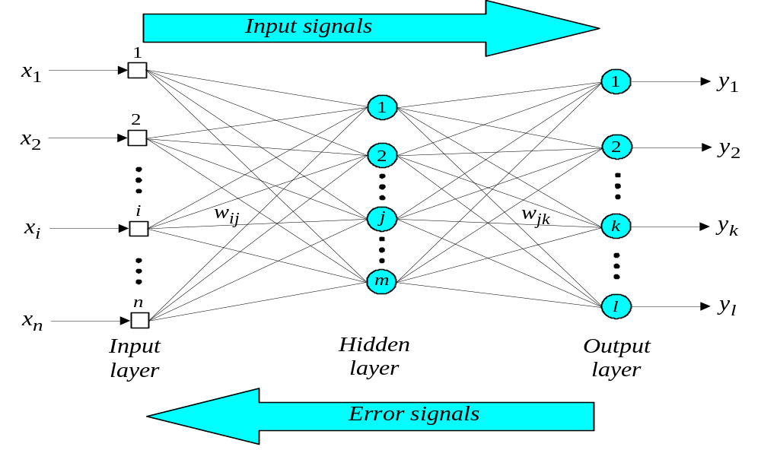
Three-layer Feed-Forward Neural Network
( trained using back-propagation algorithm)

Slide 31
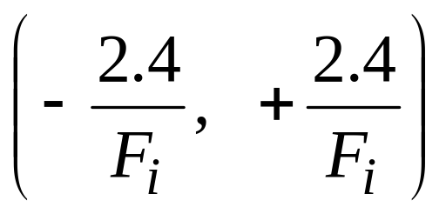
The back-propagation training algorithm
Step 1: Initialisation
Set all the weights and threshold levels of the network to random numbers uniformly distributed inside a small range:
where F_{i} is the total number of inputs of neuron i in the network. The weight initialisation is done on a neuron-by-neuron basis.

Slide 32
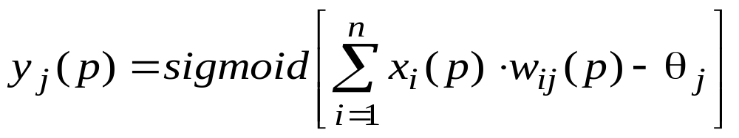
Step 2: Activation
Activate the back-propagation neural network by applying inputs x₁(p), x₂(p),…, x_{n}(p) and desired outputs y_{d,1}(p), y_{d,2}(p),…, y_{d,n}(p).
(a) Calculate the actual outputs of the neurons in the hidden layer:
where n is the number of inputs of neuron j in the hidden layer, and sigmoid is the sigmoid activation function.

Slide 33
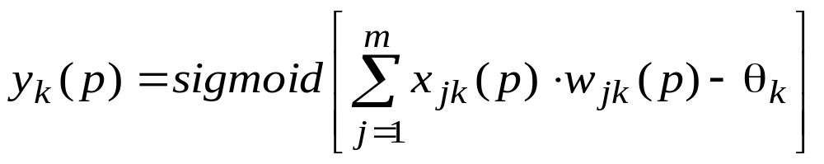
Step 2: Activation (continued)
(b) Calculate the actual outputs of the neurons in the output layer:
where m is the number of inputs of neuron k in the output layer.

Slide 34
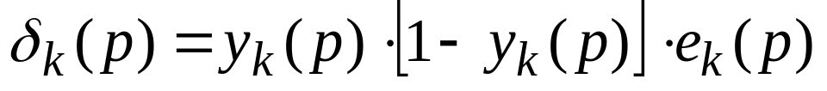
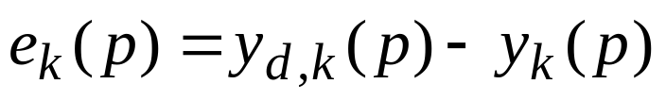
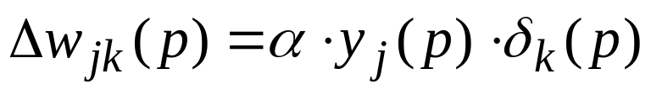
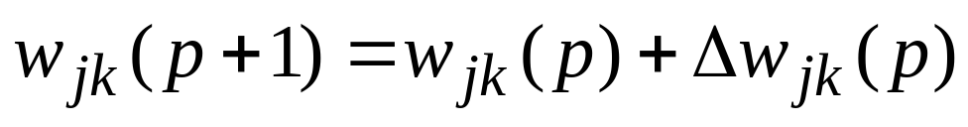
Step 3: Weight training
Update the weights in the back-propagation network propagating backward the errors associated with output neurons.
(a) Calculate the error gradient for the neurons in the output layer:
where
Calculate the weight corrections:
Update the weights at the output neurons:

Slide 35
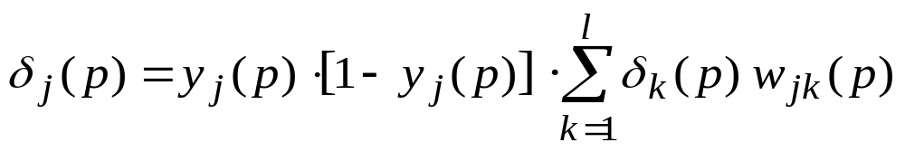
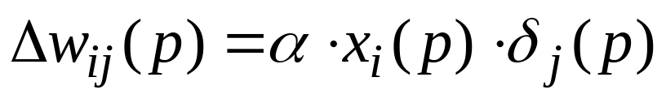
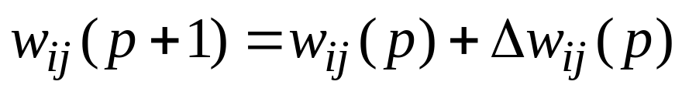
Step 3: Weight training (continued)
(b) Calculate the error gradient for the neurons in the hidden layer:
Calculate the weight corrections:
Update the weights at the hidden neurons:

Slide 36
Step 4: Iteration
Increase iteration p by one, go back to Step 2 and repeat the process until the selected error criterion is satisfied.
As an example, we may consider the three-layer back-propagation network. Suppose that the network is required to perform logical operation Exclusive-OR. Recall that a single-layer perceptron could not do this operation. Now we will apply the three-layer net.

Slide 37
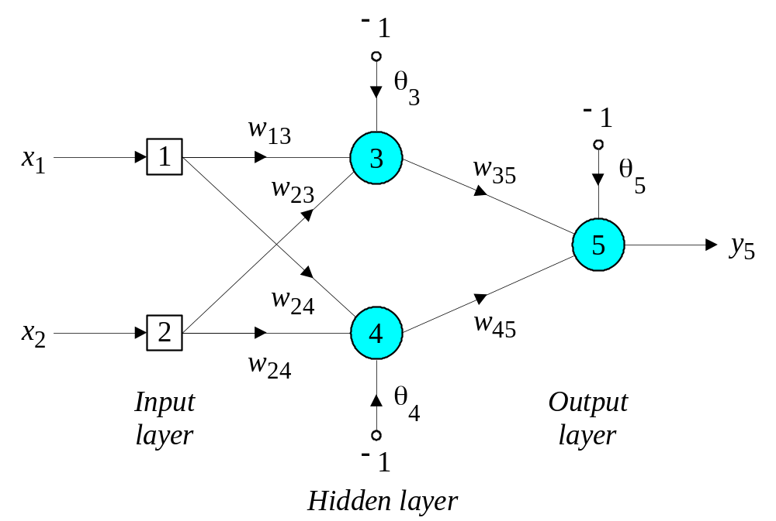
Three-layer network for solving the Exclusive-OR operation

Slide 38
The effect of the threshold applied to a neuron in the hidden or output layer is represented by its weight, θ, connected to a fixed input equal to −1.
The initial weights and threshold levels are set randomly as follows:
w₁₃ = 0.5, w₁₄ = 0.9, w₂₃ = 0.4, w₂₄ = 1.0, w₃₅ = −1.2, w₄₅ = 1.1, θ₃ = 0.8, θ₄ = −0.1 and θ₅ = 0.3.

Slide 39

We consider a training set where inputs x₁ and x₂ are equal to 1 and desired output y_{d,5} is 0. The actual outputs of neurons 3 and 4 in the hidden layer are calculated as
Now the actual output of neuron 5 in the output layer is determined as:
Thus, the following error is obtained:

Slide 40
The next step is weight training. To update the weights and threshold levels in our network, we propagate the error, e, from the output layer backward to the input layer.
First, we calculate the error gradient for neuron 5 in the output layer:
Then we determine the weight corrections assuming that the learning rate parameter, α, is equal to 0.1:

Slide 41
Next we calculate the error gradients for neurons 3 and 4 in the hidden layer:
We then determine the weight corrections:

Slide 42
At last, we update all weights and threshold:
w
=
w
+
Δ
w
=
0
.
5
+
0
.
0038
=
0
.
5038
13
13
13
w
=
w
+
Δ
w
=
0
.
9
−
0
.
0015
=
0
.
8985
14
14
14
w
=
w
+
Δ
w
=
0
.
4
+
0
.
0038
=
0
.
4038
23
23
23
w
=
w
+
Δ
w
=
1
.
0
−
0
.
0015
=
0
.
9985
24
24
24
w
=
w
+
Δ
w
=
−
1
.
2
−
0
.
0067
=
−
1
.
2067
35
35
35
w
=
w
+
Δ
w
=
1
.
1
−
0
.
0112
=
1
.
0888
45
45
45
θ
=
θ
+
Δ
θ
=
0
.
8
−
0
.
0038
=
0
.
7962
3
3
3
θ
=
θ
+
Δ
θ
=
−
0
.
1
+
0
.
0015
=
−
0
.
0985
4
4
4
θ
=
θ
+
Δ
θ
=
0
.
3
+
0
.
0127
=
0
.
3127
5
5
5
The training process is repeated until the sum of squared errors is less than 0.001.

Slide 43
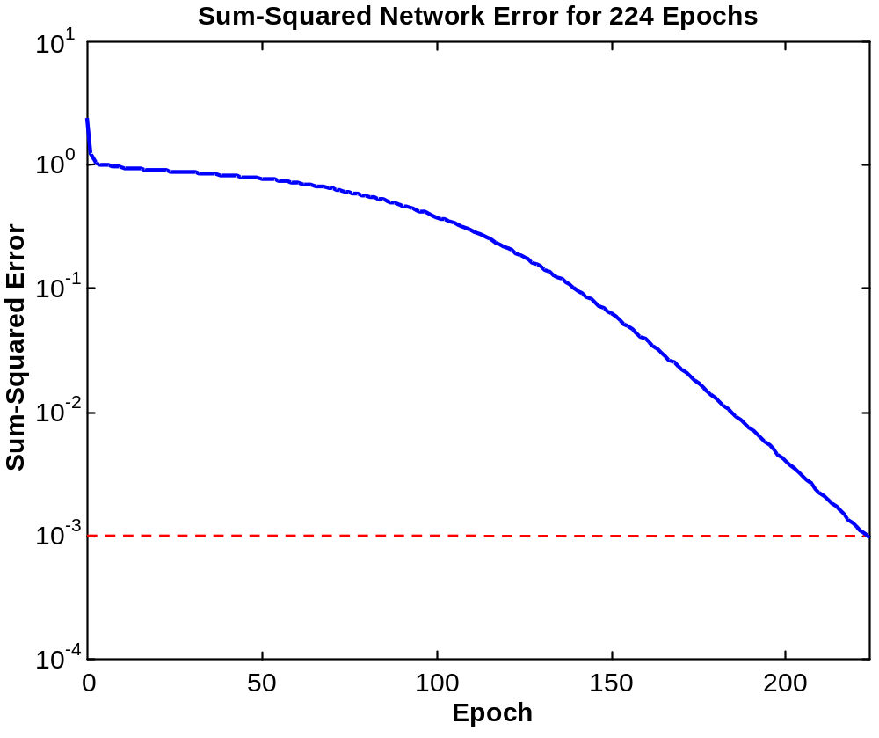
Learning curve for operation Exclusive-OR

Slide 44
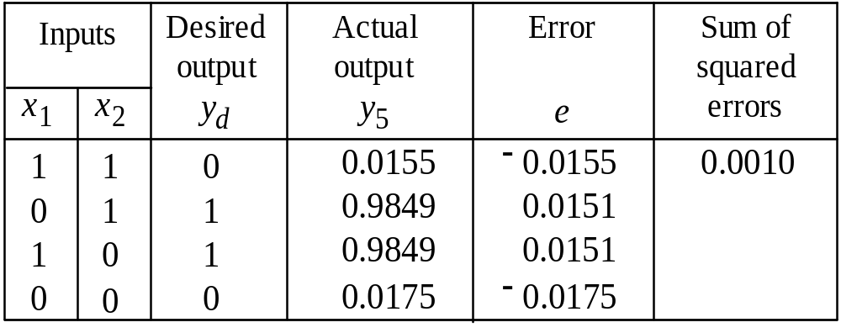
Final results of three-layer network learning

Slide 45
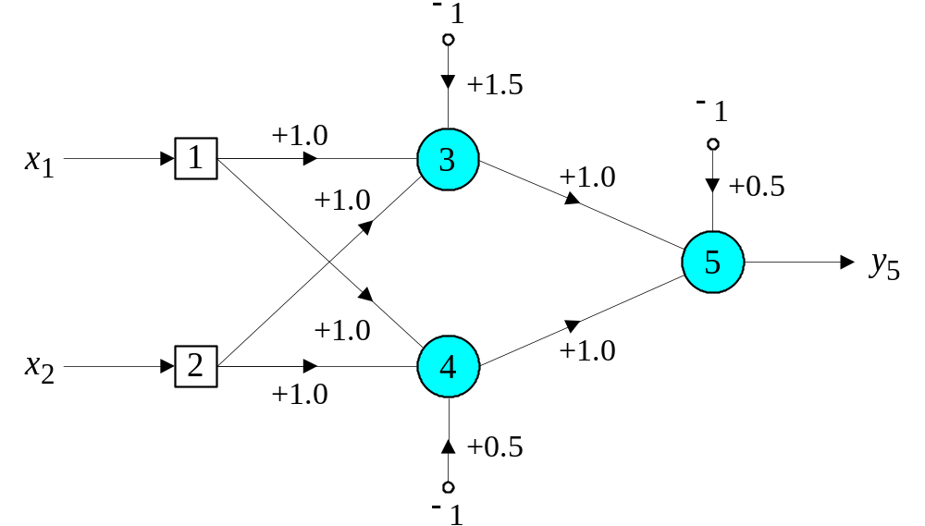
Network for solving the Exclusive-OR operation

Slide 46
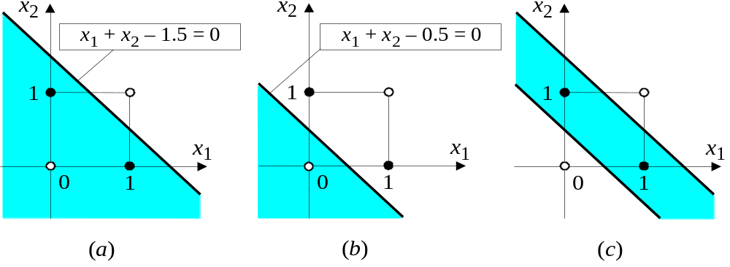
Decision boundaries
(a) Decision boundary constructed by hidden neuron 3;
(b) Decision boundary constructed by hidden neuron 4; (c) Decision boundaries constructed by the complete
three-layer network

Slide 47
Capabilities of Multi-Layer Neural Networks
expressiveness
  weaker than predicate logic
  good for continuous inputs and outputs
computational efficiency
  training time can be exponential in the number of inputs
  depends critically on parameters like the learning rate
  local minima are problematic
    can be overcome by simulated annealing, at additional cost
generalization
  works reasonably well for some functions (classes of problems)
    no formal characterization of these functions

Slide 48
Capabilities of Multi-Layer Neural Networks (cont.)
sensitivity to noise
  very tolerant
  they perform nonlinear regression
transparency
  neural networks are essentially black boxes
  there is no explanation or trace for a particular answer
  tools for the analysis of networks are very limited
  some limited methods to extract rules from networks
prior knowledge
  very difficult to integrate since the internal representation of the networks is not easily accessible

Slide 49
Applications
domains and tasks where neural networks are successfully used
  recognition
  control problems
  series prediction
    weather, financial forecasting
  categorization
    sorting of items (fruit, characters, …)

Slide 50
The Hopfield Network
Neural networks were designed on analogy with the brain.
The brain’s memory, however, works by association.
  For example, we can recognise a familiar face even in an unfamiliar environment within 100-200 ms.
  We can also recall a complete sensory experience, including sounds and scenes, when we hear only a few bars of music.
The brain routinely associates one thing with another.

Slide 51
Multilayer neural networks trained with the back-propagation algorithm are used for pattern recognition problems.
However, to emulate the human memory’s associative characteristics we need a different type of network: a recurrent neural network.
A recurrent neural network has feedback loops from its outputs to its inputs.

Slide 52
The stability of recurrent networks intrigued several researchers in the 1960s and 1970s.
However, none was able to predict which network would be stable, and some researchers were pessimistic about finding a solution at all.
The problem was solved only in 1982, when John Hopfield formulated the physical principle of storing information in a dynamically stable network.

Slide 53
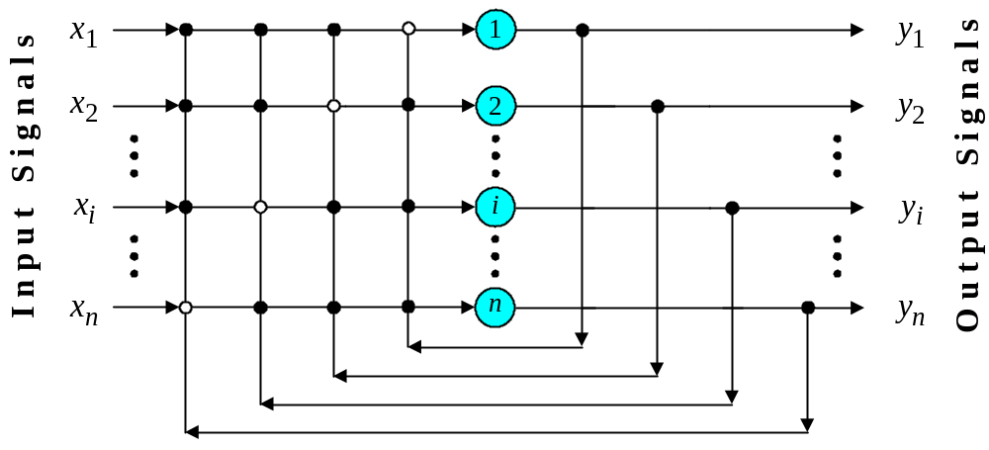
Single-layer n-neuron Hopfield network
The stability of recurrent networks was solved only in 1982, when John Hopfield formulated the physical principle of storing information in a dynamically stable network.

Slide 54
Chapter Summary
learning is very important for agents to improve their decision-making process
  unknown environments, changes, time constraints
most methods rely on inductive learning
  a function is approximated from sample input-output pairs
neural networks consist of simple interconnected computational elements
multi-layer feed-forward networks can learn any function
  provided they have enough units and time to learn

